Slide 1

Deployable Optical Receiver Array Cubesat
Genevieve Cooper

Slide 2



DORA Team
Jose Velazco (333M)
Andy Klaib
Uriel Escobar (UC Irvine)
Sean Cornish (USC)
Sarah Spector (Umilwaukee, 2020 Intern)
Charles Lindsey (MIT, 2020 Intern)
Learn More at: https://loco.lab.asu.edu/research/dora/
Danny Jacobs (PI)
Judd Bowman
Mickey Horn
Christopher McCormick (IPL)
Chandler Hutchins (IPL)
CSE Capstone Group
Zachary Hoffman (CS/Robotics)
Jah Markabowski (CS/Robotics)
Justin Colyar
Jaime Sanchez de La Vega (Vega Space Systems

Slide 3
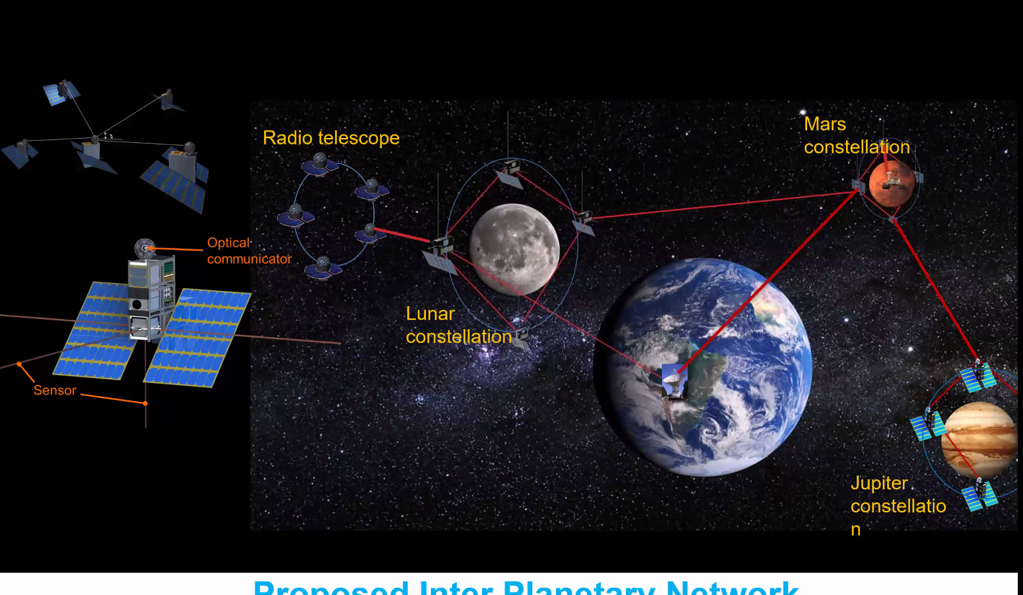
High Bandwidth Interconnection
Crosslink between spacecraft
Swarm instruments
Reduce DSN load in planetary networking

Slide 4
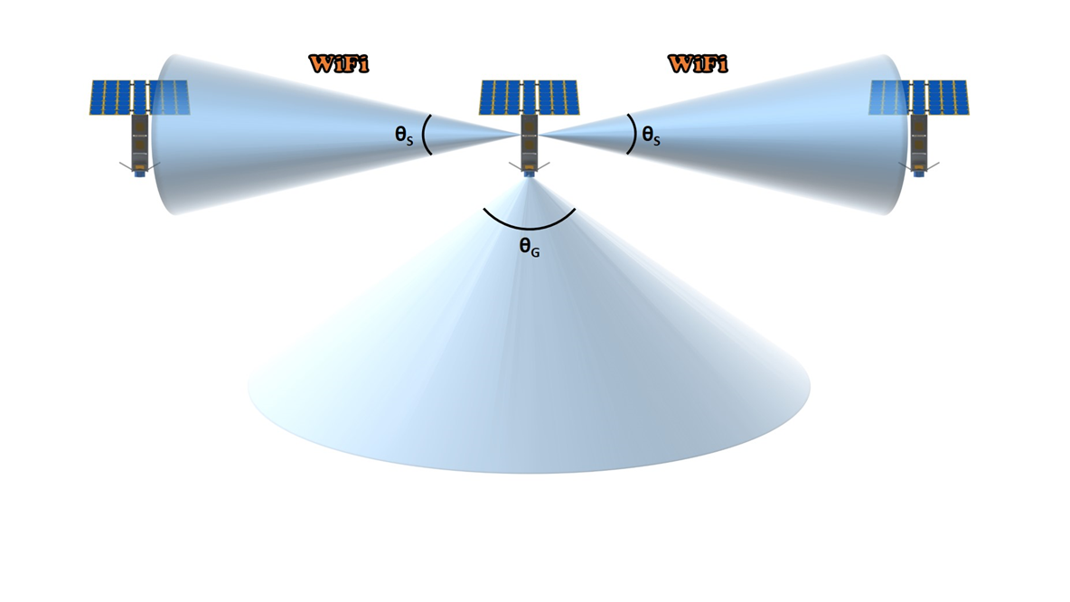
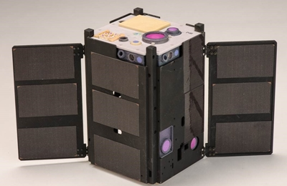

Limitations of Traditional Apertures
Tx/Rx aperture size
compact and conformal to the spacecraft body
Limits pointing freedom

Slide 5
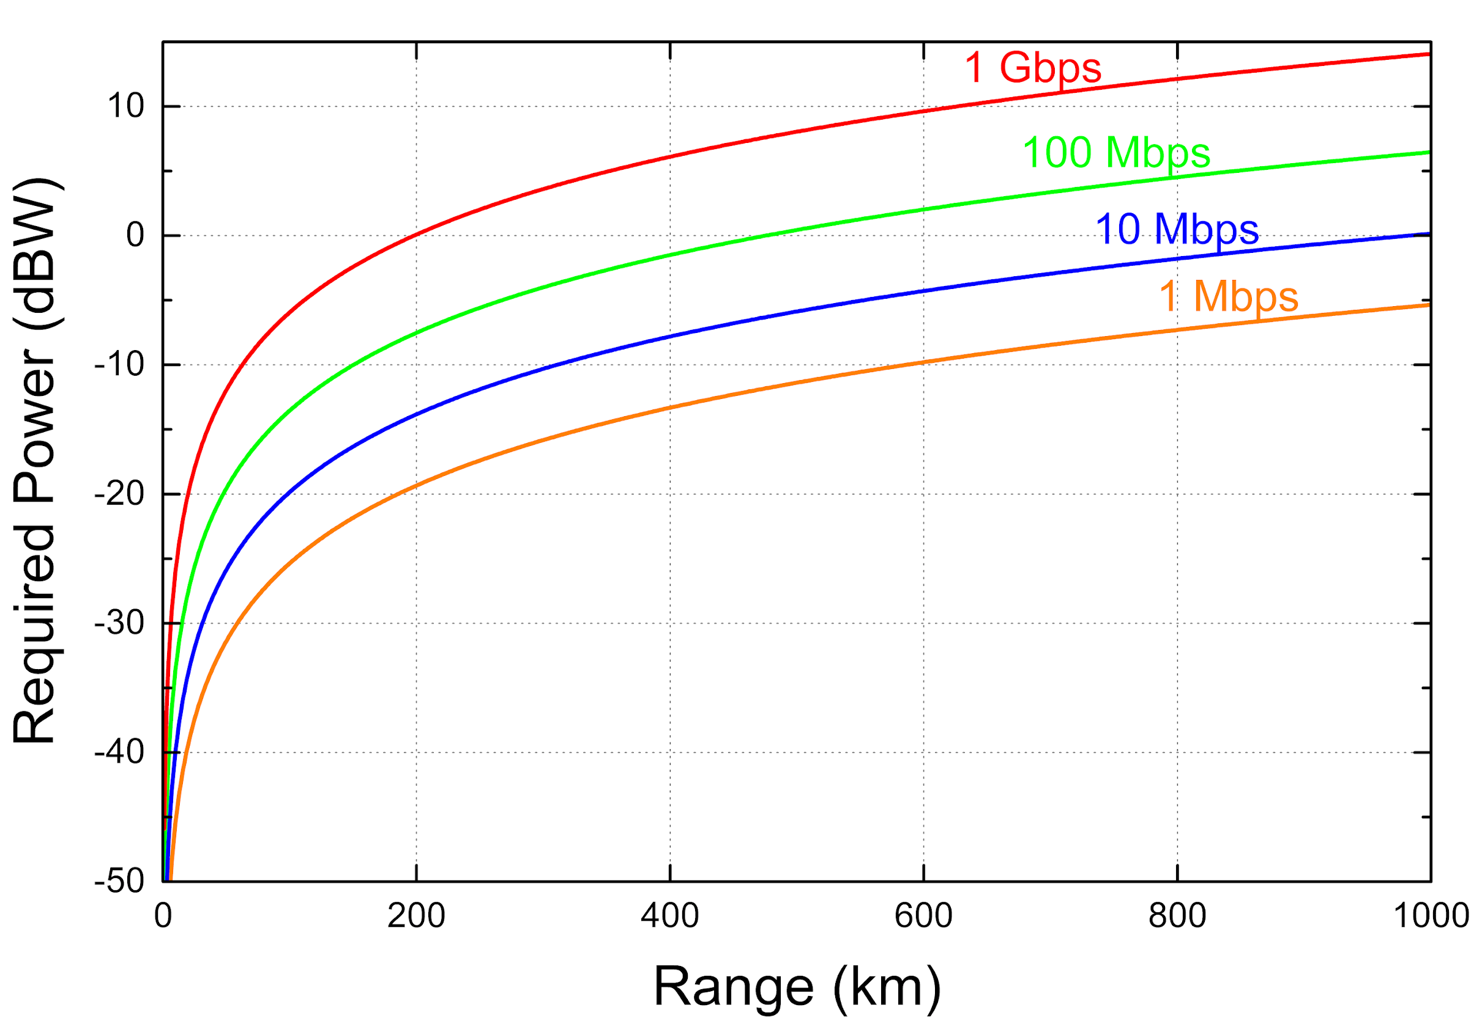
ISOC Link Budget
Tx aperture: 1 cm
Rx aperture: 2.5 cm
Graph by Jose Velazco

Slide 6
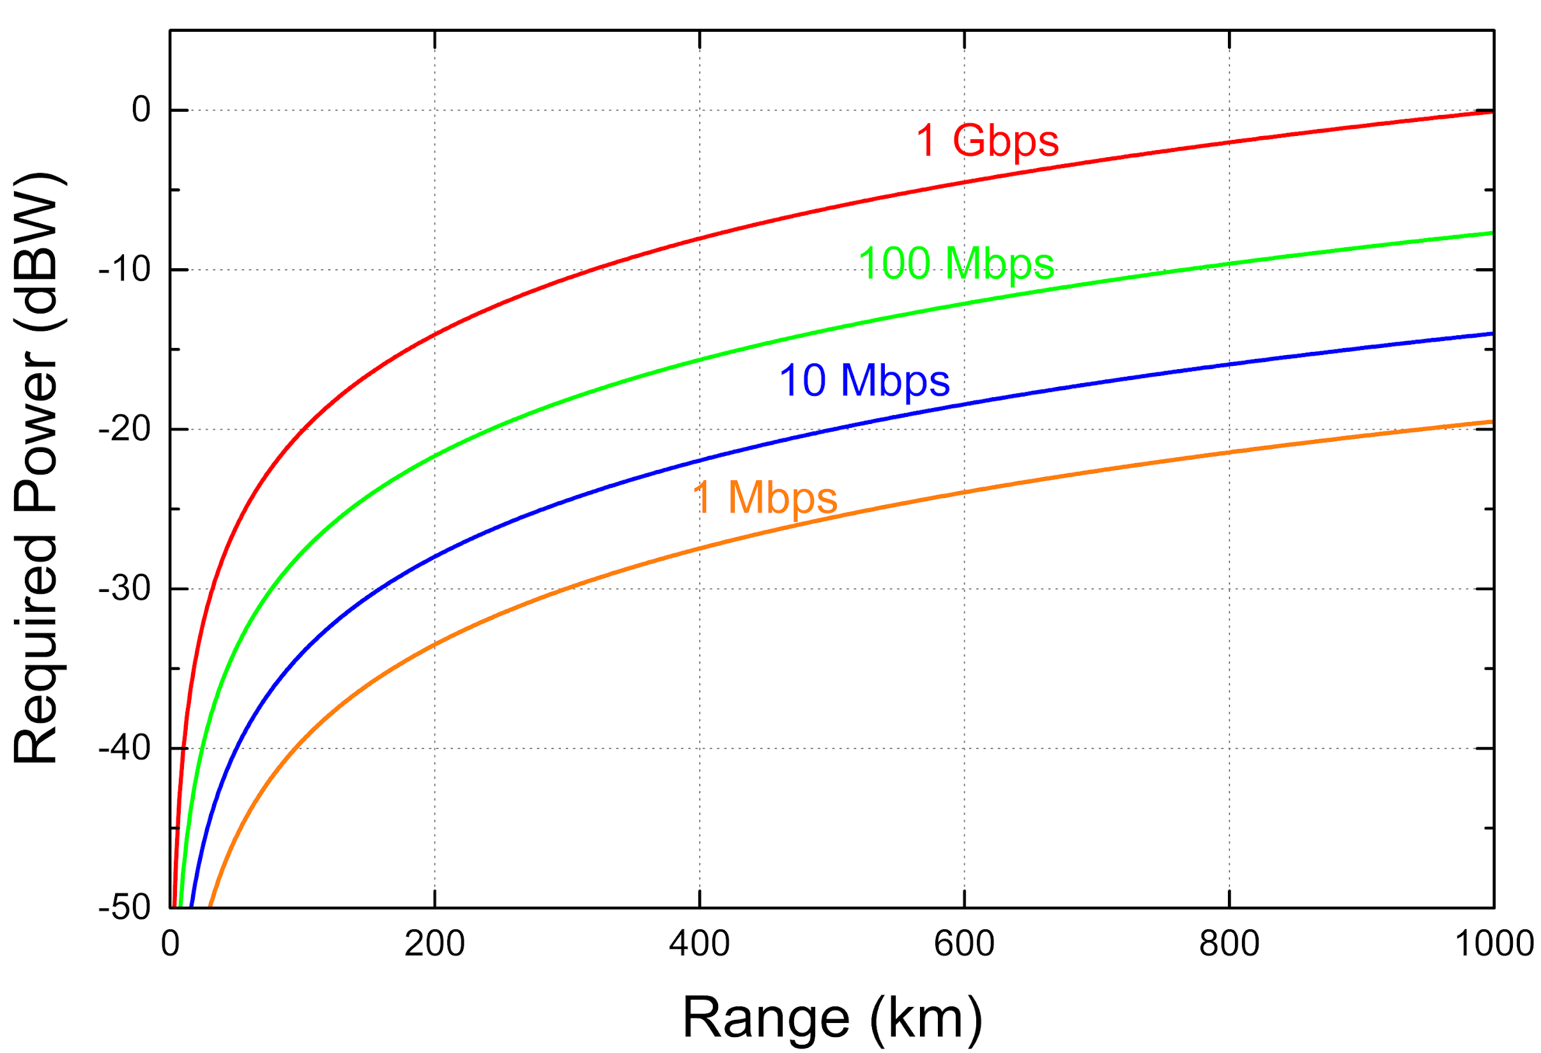
DORA Link Budget
1 Gbps@ 1,000 km
Tx aperture: 1.5 cm
Rx aperture: 7.5 cm
Graph by Jose Velazco

Slide 7
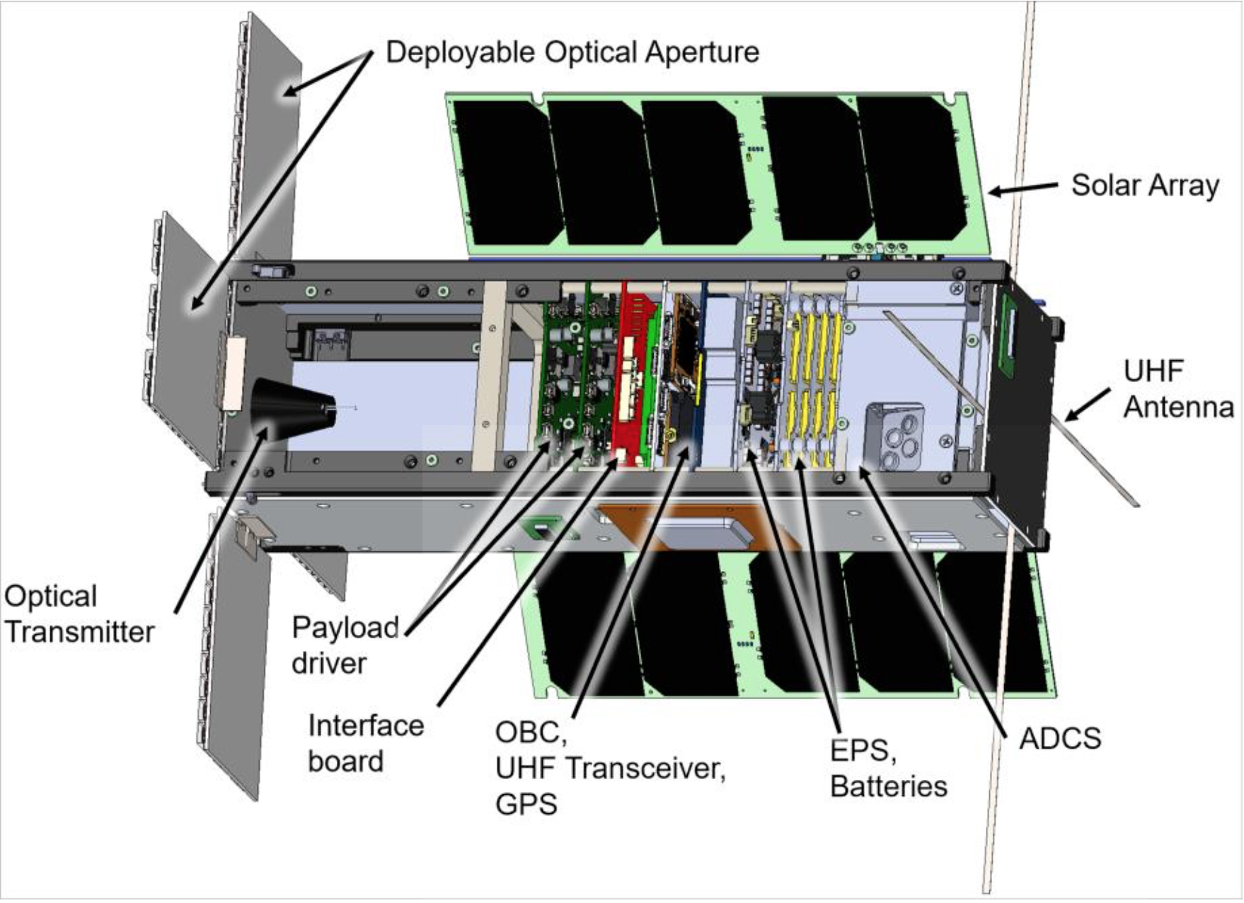
DORA Cubesat Design
Phoenix Heritage
Beagle bone computer
MAI attitude controller
Planet openLST radio
6x2U panels. 2 deployable, 4 fixed
GPS
More Batteries
KubeOS Linux-based OS
Standardized CCSDS protocol

Slide 8
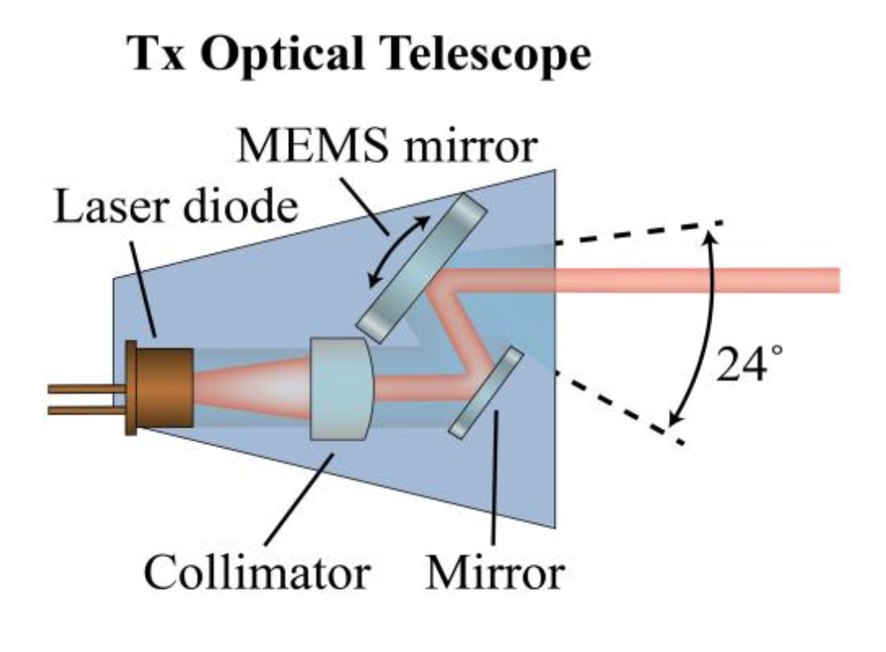
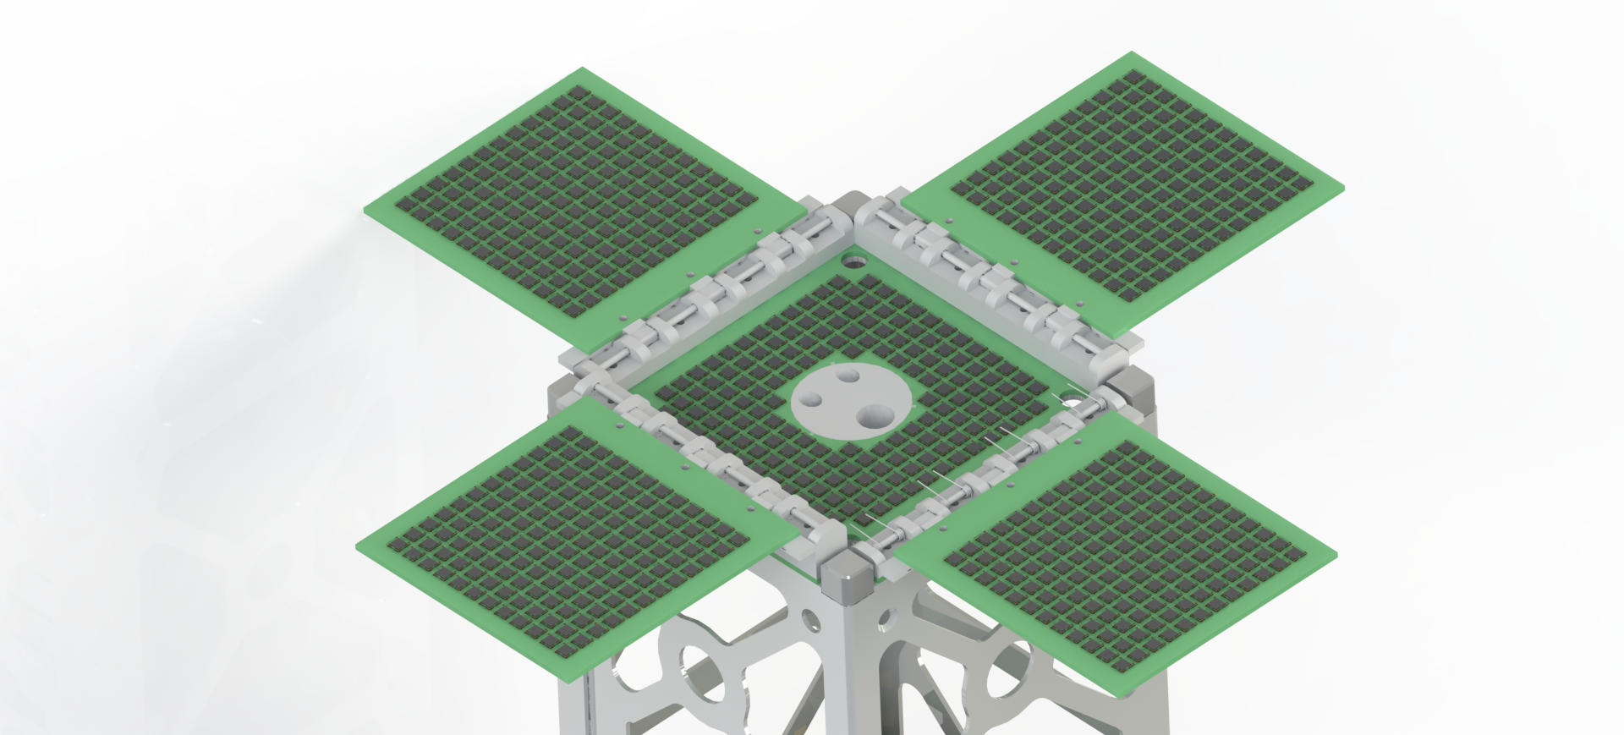
DORA Transceiver Operation
Silicon Photomultiplier detectors
Order 100 detectors combined per panel
MEMS mirror steers +/-10deg

Slide 9
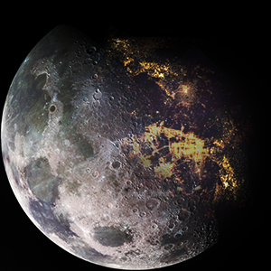
DORA Schedule
2020-2021
Panel Design and Lab Testing
Cubesat Mission Engineering
2021-2023
Flight laser terminal testing and integration
Spacecraft Integration and Testing
Ground Station Deployment
2023-2024
Flight updates
Delivery and Operation

Slide 10
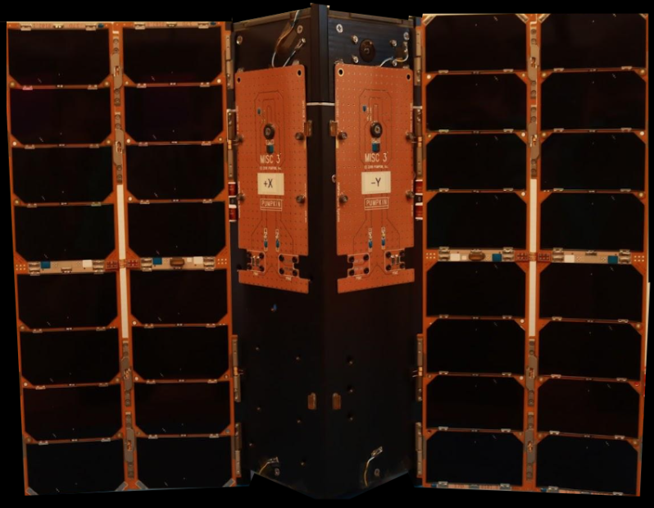
DORA Status
Fully Stacked & Assembled
Vibe Tested - Passed
Long Range Radio Test - Passed
Ready for Handoff to Launch Provider

Slide 11
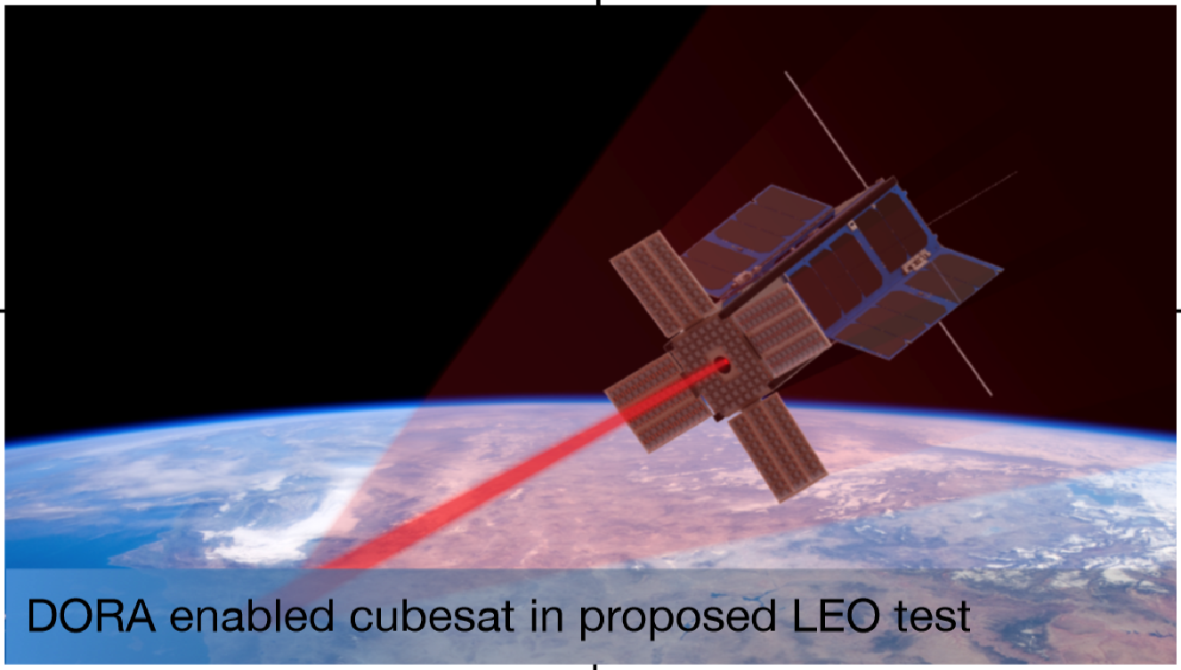
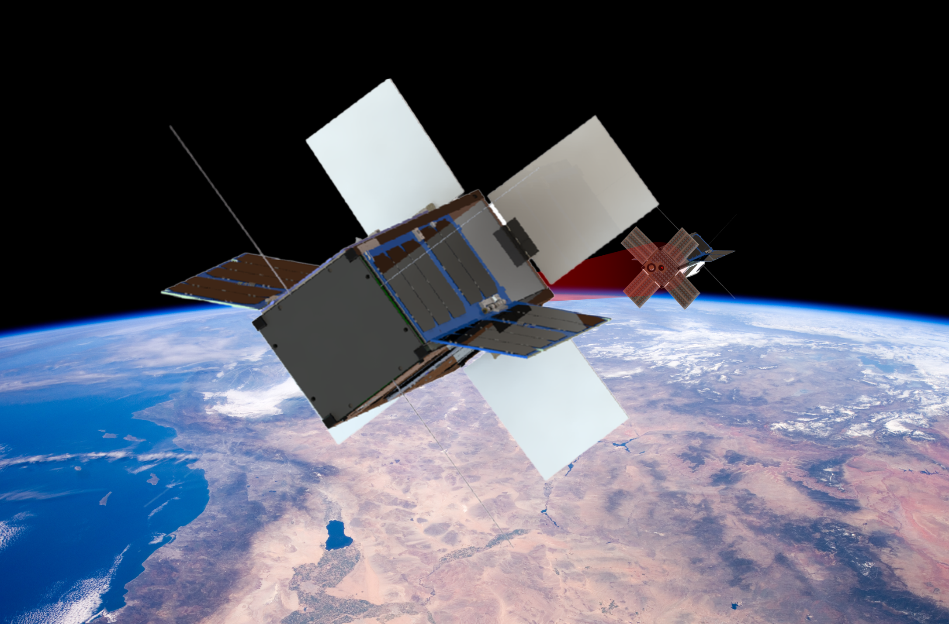
This project: Lab to Flight
DORA Roadmap
Next: Cross-link
ASU – Cubesat, Ground Station, Attitude Testing
JPL – DORA Payload
Renderings by Jaime Sanchez de La Vega

Slide 12
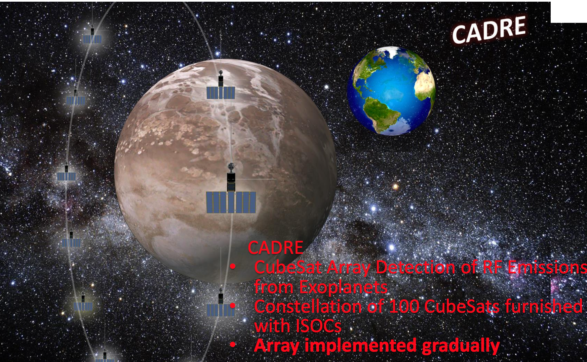
Slide by Jose Velazco

Slide 13


Thank You

